Slide 1
Legal Chat Advisory
Presented By
Abhishek S Patil
Anagha Bhupalam
Ananya N. Ambli
Anirudh B M

Slide 2
INTRODUCTION
Today, lawyers face the problem of routine and unbilled tasks. Their workdays mainly consist of administrative, financial and advertising task.
A chatbot is a software system that can interact or “chat” with a human user in natural and understandable language.
Legal chatbots are great way of optimizing a work process to save lawyer’s time. The chatbot works 24/7 to provide customers with legal help whenever they need it. Chatbots generate and analyse legal documents, perform due diligence and provide legal information to the clients as well as the law firms.

Slide 3
MOTIVATION
Today, lawyers face the problem of routine and unbilled tasks. Their workdays mainly consist of administrative, financial and advertising task.
However, they still have clients that need advice or legal documents created. In a hunt to increase revenue and raise client’s satisfaction, most lawyer’s work more than they were planning.
One of the solutions to reduce this is the chatbot
Legal chatbots are great way of optimizing a work process to save lawyer’s time. The chatbot works 24/7 to provide customers with legal help whenever they need it.
Chatbots generate and analyse legal documents, perform due diligence and provide legal information to the clients as well as the law firms.

Slide 4
PROBLEM STATEMENT
The legal law firms are constantly seeking to expand their technologies, both to improve client service and increase efficiency and revenue through the advancements in technology. A domain specific chatbot will be implemented to assist users with the basic rules and regulations of law and also the IPC sections under the constitution. The chatbot will allow users to feel confident and comfortable when using this service regardless of the user’s computer literacy due to the natural language used in messages.

Slide 5
OBJECTIVES
As searching information about particular article is time consuming, a system is designed to provide concise information about the article by
Constructing a database.
Training the system using NLP and ML algorithms.
Lawyer’s time will be utilized efficiently as they can now concentrate on a particular case.
The end user can get the information about an article with ease.

Slide 6
LITERATURE SURVEY
Integrated legal information retrieval
Ross Intelligence
LISA
DoNotPay
Billy Bot

Slide 7
PROJECT OUTCOMES
Designed an interactive chat bot for Providing Legal Information.
Provides concise and pithy information about the article.
Provides information about previous similar cases pertaining to that article (e.g. Blogs of lawyers).
Fetches related information about that case or article (link to the actual article).
The advisory is able to retrieve information in fast and efficient manner while simultaneously providing a higher response rate.

Slide 8
Provides information about previous similar cases pertaining to that article (e.g. Blogs of lawyers).
Fetches related information about that case or article (link to the actual article).
The advisory is able to retrieve information in fast and efficient manner while simultaneously providing a higher response rate.

Slide 9
TECHNOLOGY STACK
Python
Django
JSON
Rest API
AWS S3, EC2, cloud 9, API Gateway
MySQL
RASA

Slide 10
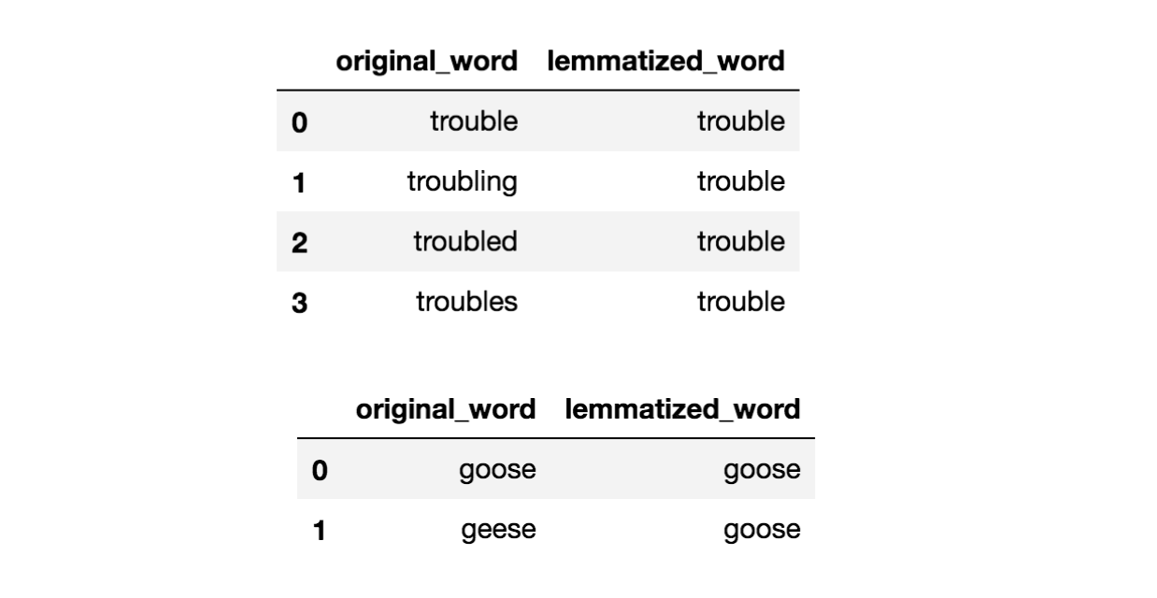
WORKING
Text Pre-Processing
All the sentences have to undergo text-preprocessing which includes converting the sentences into lower case, removing the stopwords, removing all kinds of punctuations, HTML tags(if any) and lemmatizing all the words in the sentences.
Lemmatization is the process of grouping together the different inflected forms of a word so they can be analysed as a single item. Lemmatization is similar to stemming but it brings context to the words. So it links words with similar meaning to one word.

Slide 11
There are multiple policies used by RASA to determine the next action to be taken in a conversation.
Responding to simple intents
Simple intents include contents like greeting a user, thanking the user or responding to the exit of the user. This is done by Memoization Policy inbuilt in RASA.
Responding to more complex intents
If a rule based policy is able to make a prediction, that prediction will always have a higher priority and predict the next action. The ML based policies give your assistant the chance not to fail
This type of user behavior is handled by TED Policy.

Slide 12
TED POLICY
TED policy takes three pieces of information as input: the user’s message, the previous system action that was predicted, and any values saved to the assistant’s memory as slots. Each of these is featurized and concatenated before being fed into the transformer.
The transformer accesses different parts of the dialogue history dynamically.
Next, a dense layer is applied to the transformer’s output to get embeddings—numeric features used to approximate the meaning of text

Slide 13
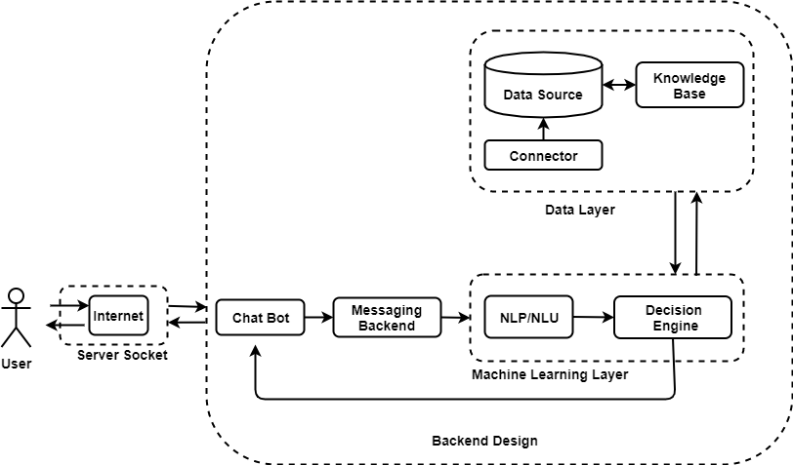
BLOCK DIAGRAM

Slide 14
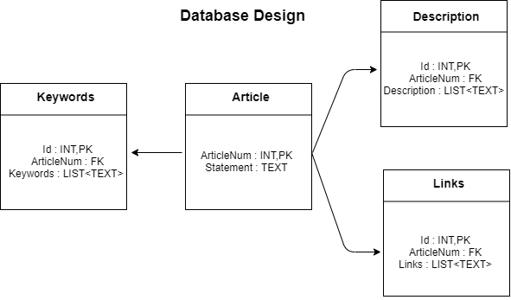
Design
Database Design
Database used Mysql, NoSql
ORM Based tool
Tables are Article, Keywords,
Description, Links
Hosted on AWS EC2 Instance

Slide 15
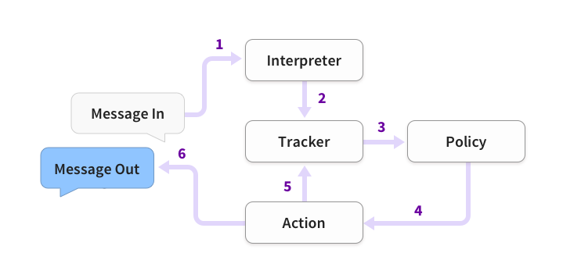
ML Model Design
Rasa Open-Source Conversational AI Framework
NLP, NLU based algorithm
3 phases Training, Testing,
Deployment
Deployment is on AWS
Steps in training
The message is received and passed to an Interpreter, which converts it into a dictionary including the original text, the intent, and any entities that were found. This part is handled by NLU.
The Tracker is the object which keeps track of conversation state. It receives the info that a new message has come in.
The policy receives the current state of the tracker.
The policy chooses which action to take next.
The chosen action is logged by the tracker. A response is sent to the user.

Slide 16
IMPLEMENTATION
We have implemented our project using the Software requirements mentioned earlier.
The flow goes something like,
User enters the query
It is collected by html file which makes a call to backend url
The query is than parsed and keywords are extracted.
Particular actions are triggered based on the keywords extracted.
Accordingly the data is fetched from the data store.
And the response is sent back to html file which displays it to the user.

Slide 17
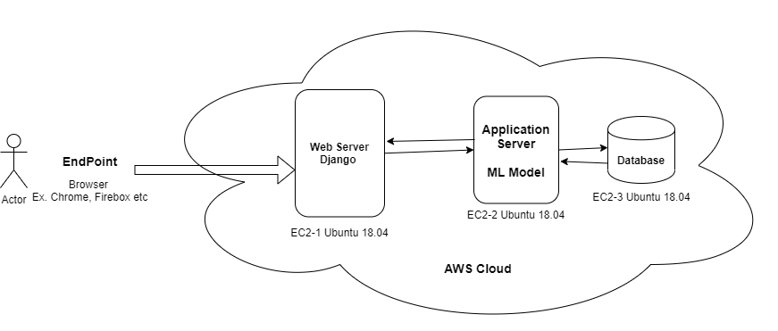
DEPLOYMENT
Web APP Deployment
Tools Used are AWS EC2, MYSQL, API GATEWAY

Slide 18
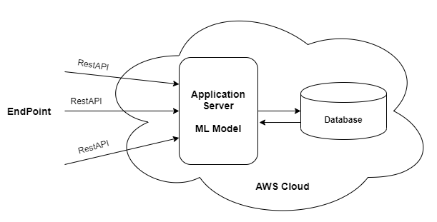
ML Model Deployment
Tools Used are AWS EC2, MYSQL, API GATEWAY

Slide 19
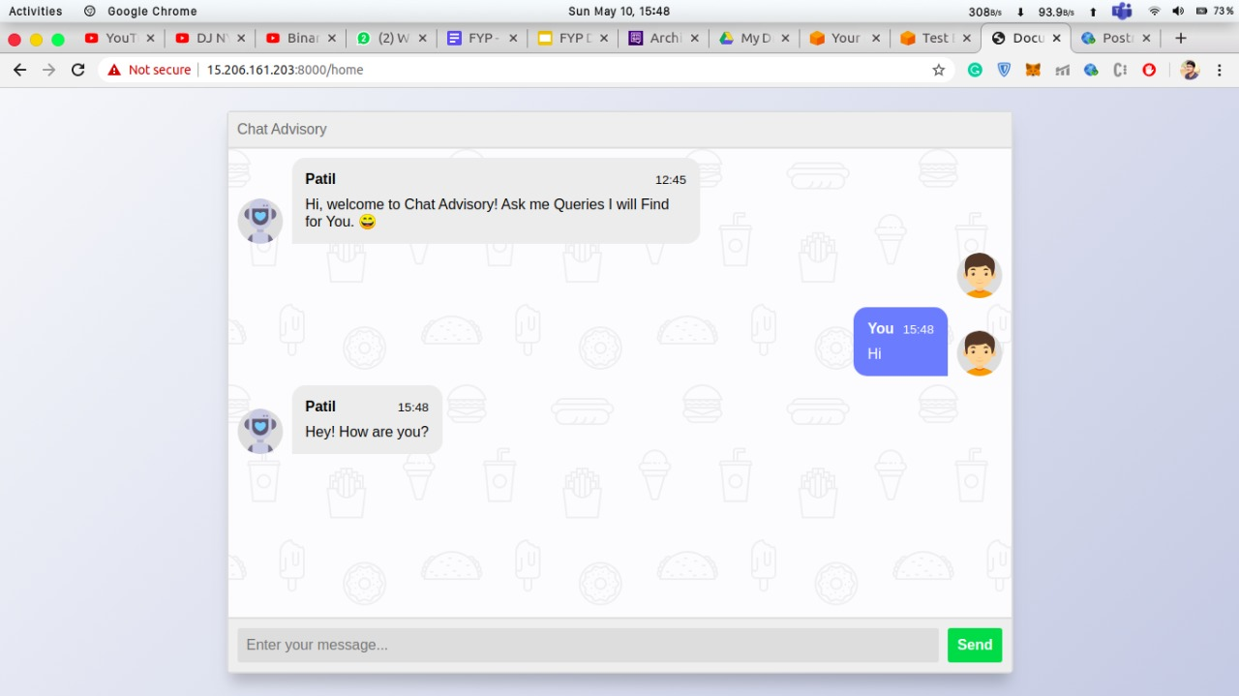
RESULTS

Slide 20
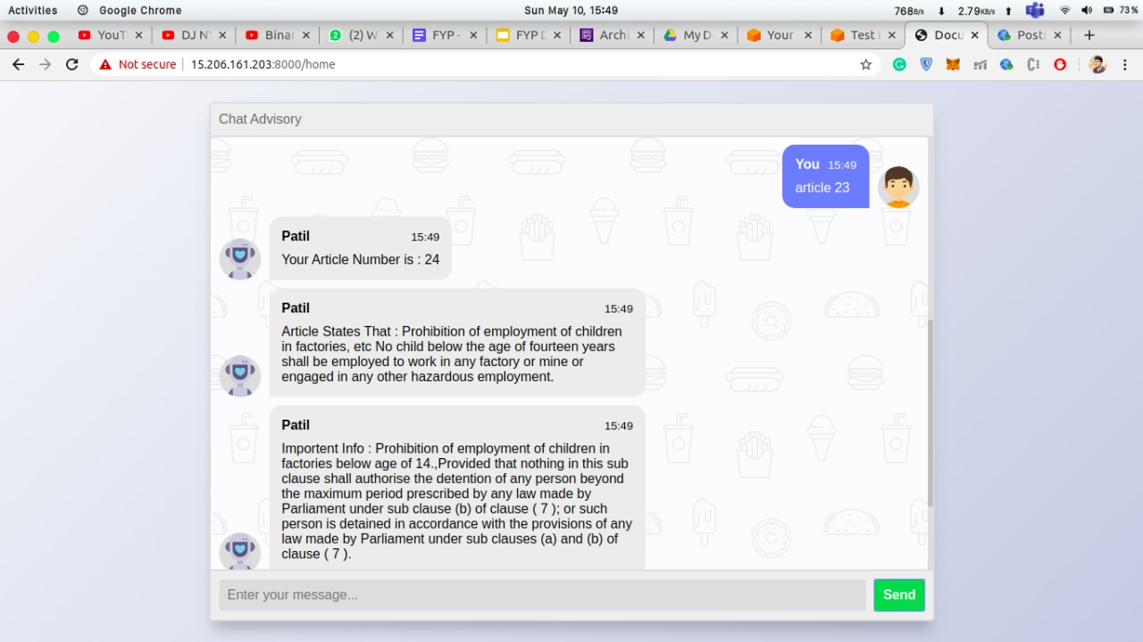

Slide 21
ADVANTAGES
Our chatbot is made interactive and very user friendly so that any type of person having any level of knowledge will be able to comfortably use the application to get response to any of his queries.
User need not waste lot of his time in researching about his issue and looking up into multiple links.
Since the website is hosted in AWS EC2 instance, it can be accessed from anywhere using just the domain name.
The users need not spend their huge amount of money in going to a lawyer and asking for a solution, whereas same amount of information is provided in our website.
The users can learn from previous cases which are related to their case and can take necessary actions in tackling their issue.
Our website helps in providing concise information related to the users and in a way which is easily understood by them.
The response time of the application is very quick and smooth.

Slide 22
DRAWBACKS
The current implemented app is limited to a few articles which can be later expanded to a bigger domain.
This application is country specific, where the implementation of this app in different countries requires adhering to their constitution rules and regulations.
The chatbot will not be able to answer questions other than legal case issues.
If the entered user text is either not with a clear explanation or involves with lot of jargon, the issue may not be mapped to the actual article sometimes.

Slide 23
APPLICATIONS
Specific content delivery.
Resolving complaint or problems.
Automated customer support for similar queries.
Restaurant applications, Flight and Bus ticket booking, Content delivery, Market and Research analysis, Health care, E-Commerce and Legal information.

Slide 24
CONCLUSION
The user can chat with the chatbot if he wishes for some time and can start asking his legal related issues. The chatbot picks up important phrases from the text and is made sure that the query of the user is tagged to the related article and providing him with a brief description about the article, previous related similar cases and also important links pertaining to that article.
With the help of previous cases, the user can link his issue with the one already happened and can take necessary actions required to his problem. The machine learning algorithm in the backend makes sure that the articles are properly mapped to the user queries.

Slide 25
FUTURE ENHANCEMENTS
The currently developed website can be made as an Android or IOS app so that it will be more accessible and convenient for the user to interact.
The mobile app can be made such that, the user can interact with chatbot to get his basic queries cleared (like getting to know the article number or general interactions etc.) without connecting to the internet.
The machine learning model can be further developed using the feedback from users so that the model becomes much more accurate in predicting.
Multiple access level can be given to the users so that the common people will not be having access to sensitive information which only lawyers can see.
Can create a community where the people with similar issues can have a conversation with each other to resolve their legal case issues much faster.
Our application can be tied with some professional lawyers so that the lawyers can quickly take up the case in case of urgency from the user.

Slide 26
Thank You

